Slide 1
MOBILE MONEY AND FINANCIAL INCLUSION IN TANZANIA PROJECT
GROUP 7

Slide 2
CONTENT
Group Members
Problem Statement
Objective
Significance
Dataset Description
Others

Slide 3
1. Group Members
Candy Jeremiah
Hussein Mzenzi
Pawa Makeresia

Slide 4
2. Problem Statement
A small percent of people in Tanzania have bank accounts and a lot more of Tanzanians who don’t have bank accounts do other types of formal financial services, primarily, mobile money.
Mobile money has become an important entry point to financial inclusion for people who have been traditionally excluded from the formal financial systems in Africa. It is increasingly becoming a platform for people to access a broad range of financial services.
This means mobile money clients and markets are increasing exponentially all over Tanzania and hence mobile money providers need a way to be able to thoroughly target the said increasing markets and clients for better effectiveness.
By predicting which individuals are most likely to use mobile money, a precise target area can also be attained.

Slide 5
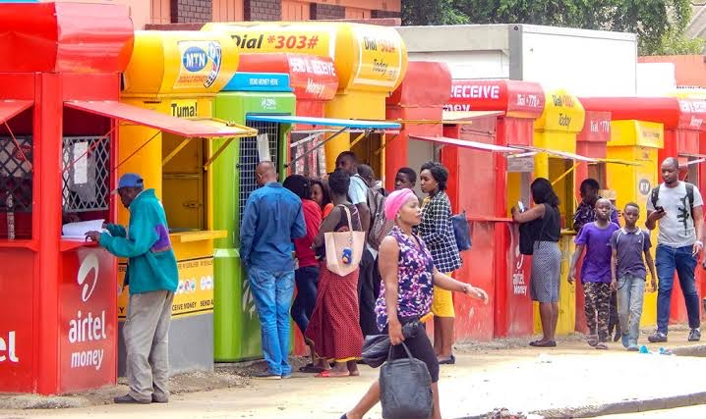

Slide 6
3. Objective
The objective of this project is to predict which individuals are most likely to use mobile money.
The goal is to accurately classify each individual into four groups;
Individuals who do not use mobile money, do not save, do not have credit, and do not have insurance.
Individuals who do not use mobile money but use at least one of the other financial services.
Individuals who use mobile money only
Individuals who use mobile money and at least one other financial service

Slide 7
4. Significance
This model can help mobile money providers target new clients and markets across Tanzania more effectively and hence increase profits among their business organizations.
Also, it provides better financial convenience for the said markets and clients.

Slide 8
5. Dataset Description
Shape of the dataset
The dataset to be used has 7094 rows and 37 columns
Data types
Data in only two columns are of float type. The rest are integers.
Features
These are all columns except the target column which is “mobile_money_classification”. And these are;
ID, Q1, Q2, Q3, Q4, Q5, Q6, Q7, Q8, Q8_1, Q8_2, Q8_3, Q8_4, Q8_5, Q8_6, Q8_7, Q8_8, Q8_9, Q8_10, Q8_11, Q9, Q10, Q11, Q12, Q13, Q14, Q15, Q17, Q18, Q19, Latitude, Longitude, mobile_money, savings and borrowing.

Slide 9
6. Others
Missing values
There are no missing values in our dataset.
Evaluation Metrics
This is used to assess how well the results are.
Here, the Evaluation Metric specified is Log Loss.
Log Loss is how close the prediction probability is to the actual value. The more the predicted probability diverges from the actual value, the higher the log loss value.

Slide 10
THANK YOU!!

